Slide 1
Piecewise nonlinear mixed-effects model for modelling Nasal Potential Difference
Rozet Eric ¹*, Natalis Laurent ¹ Matthee Bianca ², Swildens Jim ², Ritsema Tita ², Beumer Wouter ² and Boulanger Bruno ¹
¹ Arlenda S.A., Liège, Belgium
² ProQR Therapeutics B.V., Leiden, the Netherlands
eric.rozet@arlenda.com

Slide 2
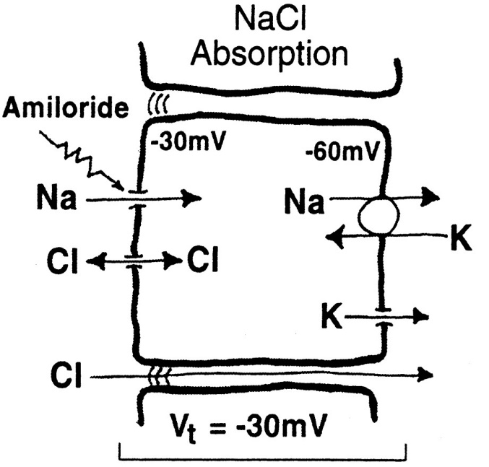
How to measure transepithelial ion transport abnormalities in vivo?
Channel proteins regulate the salt content of fluids that cover epithelia (nose, lungs)
Transport of ions generates an electrical potential difference (mV) across the airway lining
By measuring this potential difference, transepithelial ion transport function can be indirectly assessed
Channel proteins
-30mV

Slide 3
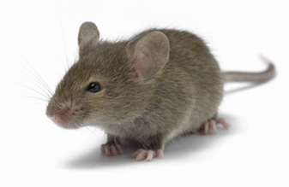
NPD, a simple but efficient measure of the transepithelial ion transport function
Potential difference can be measured by placing an electrode on the lining of the nose
This measure is termed the Nasal transepithelial Potential Difference (NPD)
NPD is a sensitive method to detect dysfunction(s) of channel proteins (e.g., Cystic Fibrosis detection)
NPD (mV)

Slide 4
How to measure transepithelial ion transport abnormalities in vivo?
NPD can be modified to follow predictable curves by bathering the nose in a succession of solutions
These solutions change the flow of ions (and thus NPD) in predictable ways
Solution 2
Solution 3
Solution 1
Treatment A
NPD (mV)
Treatment B
Time (hrs)
The effect of experimental treatments on the ion transport can be assessed by comparing NPD profiles

Slide 5
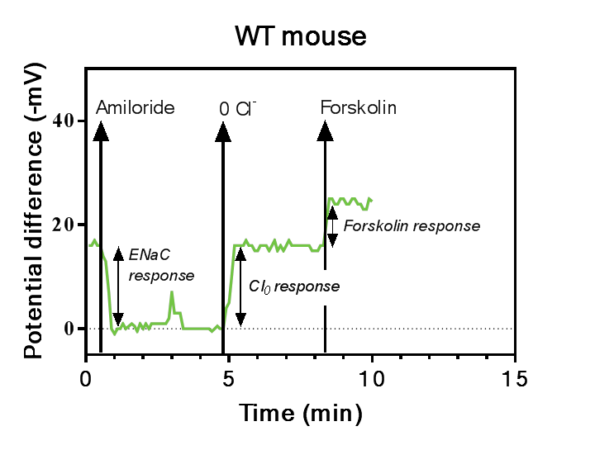
How to measure transepithelial ion transport abnormalities in vivo?
Typical NPD measurement in wild-type (WT) mouse
Total Chloride (Cl) response is calculated by adding the Cl₀ and Forskolin response values
More info: Saussereau et al., 2013, Characterization of Nasal Potential Difference in Knockout and F508del-CFTR Mice, PloS one
Total Chloride resp

Slide 6
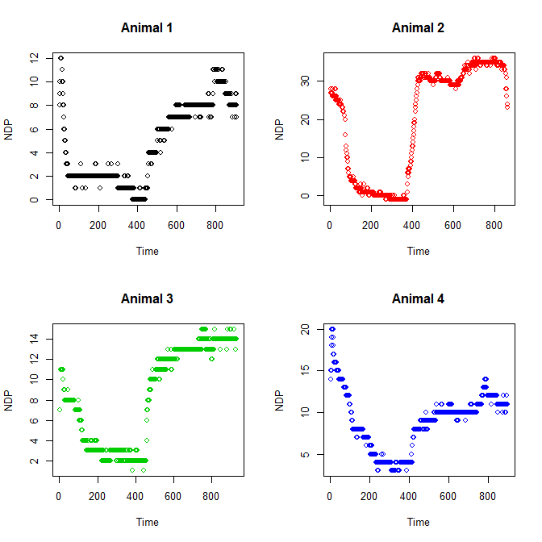
Between animal variability
Same treament to all animals

Slide 7
Nonlinear piecewise mixed effect model
For the i^{th} subject and j^{th} measurment
Add change points: $γ_{k}$: for k=1 to K phases
$$y_{ij}=f\left(φ_{i},t_{ij}\right)+ε_{ij}$$
$${ε_{ij}\sim N}_{ij}(0,σ_{}^{})$$
$$ε_{ij}⊥b_{i}$$
$$φ_{i}=A_{i}β+{B_{i}b}_{i}$$
$${b_{i}\sim N}_{ij}(0,D)$$
$$f\left(φ_{i},t_{ij}\right)=\left\{\begin{aligned}f_{1}\left(φ_{i1},t_{ij}\right) t≤γ_{i1} \\ f_{k}\left(φ_{ik},t_{ij}\right) γ_{i(k−1)}<t≤γ_{ik} \\ f_{K}\left(φ_{iK},t_{ij}\right) t>γ_{i(K−1)}\end{aligned}\right.$$

Slide 8
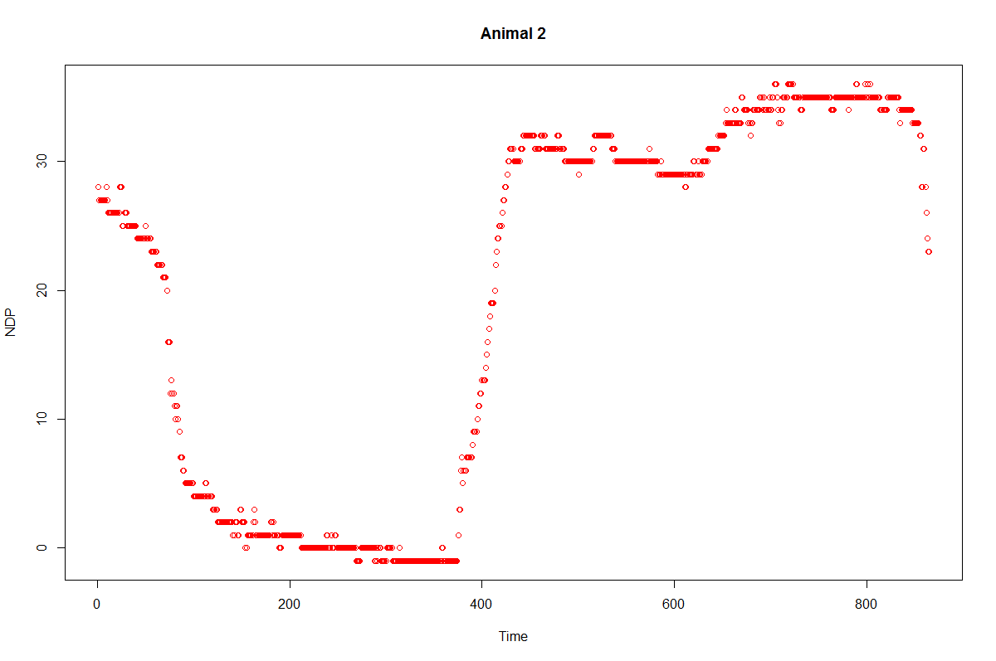
The Phases of the nonlinear mixed model
$$γ_{1}$$
$$γ_{2}$$
$$f_{1}\left(φ_{i1},t_{ij}\right)$$
$$f_{2}\left(φ_{i2},t_{ij}\right)$$
$$f_{3}\left(φ_{i3},t_{ij}\right)$$

Slide 9
The Phases of the nonlinear mixed model
$$f\left(φ_{i},t_{ij}\right)=\left\{\begin{aligned}φ_{i1}exp\left(−φ_{i2}t\right) t≤γ_{1} \\ φ_{i3}(1−exp\left(−φ_{i4}(t−γ_{i1}\right))) γ_{1}<t≤γ_{2} \\ φ_{i5}(1−exp\left(−φ_{i6}(t−γ_{i1}\right))) t>γ_{2} \\ \end{aligned}\right.$$
$$φ_{ki}=β_{ki}+β_{ki}Treatment+b_{ki} (k=1,…,6)$$

Slide 10
Results: for 3 treatments

Slide 11
Statistical Inference
To assess the effect of the treatment on the several responses of interest we constructed Wald confidence intervals:
Difference with control 1 | Estimate | Low 95% CI | Up 95% CI | p-value
ENac_ 1 - 2 | 4.667702145 | 4.057007169 | 5.278397121 | 1.862E-50
ENac_ 1 - 3 | 6.502495836 | 5.890843442 | 7.11414823 | 2.1933E-95
OChloride_ 1 – 2 | 9.206056721 | 8.733436463 | 9.678676979 | 1.41E-307
OChloride_ 1 – 3 | 12.97101809 | 12.49389154 | 13.44814464 | 0
Total_ 1 – 2 | -0.3513387 | -0.67938118 | -0.02329623 | 0.0358048
Total_ 1 – 3 | -0.44712366 | -0.7765237 | -0.11772362 | 0.00780664

Slide 12
Conclusion
We developed a piecewise nonlinear mixed-effects model to describe the dynamics of repeated NPD measurements before and after a treatment
To evaluate the treatment effect, we constructed hypothesis tests for several NPD profiles variables
Mixed-effects model constitutes an efficient and flexible tool for the analysis of longitudinal data
This study provides a new analytical tool for the analysis of NPD studies
Thank you for your attention!

Slide 13
Contact: Eric Rozet, Statistician
Eric.Rozet@arlenda.com
+32 (0) 473 690 914
www.arlenda.com

