Slide 1
Control Chart to Monitor Quantitative Assay Consistency Based on Autocorrelated Measures
A. Baclin, M-P. Malice, G. de Lannoy, M. Key Prato
GlaxoSmithKline Vaccines, R&D Biostatistics
NCSC 2014
October 8 - 10, Bruges, Belgium

Slide 2
Outline
Introduction and objectives
EWMA methodology
IID assumptions vs. real-life correlations
Within-day correlations
Between-day correlations
Practical recommendations

Slide 3
Introduction
Quantitative laboratory assays (i.e. ELISA) use a control material to (in)validate assay results
The control is a (pool of) sample(s) or a standard with enough quantity to be tested over a long time period with a large number of assays runs
Multiple control measurements per day over the time period of interest (i.e. from different operators or labs)
Practitioners want to detect shifts in assay results via monitoring of the control over time
→ Different objective than control limits to (in)validate results!
Notes:
Describe context in which this data is obtained

Slide 4
Objectives
Detect deviations from a supposed target (i.e. the mean or the theoretical value)
Prime concern of practitioners is false alert reduction
Tool as stable and standard as possible (# assays > 300)
→ Control charts are recommended for SPC (Shewhart, CUSUM, EWMA, ...)
EWMA among the most powerful to detect small shifts (~ 1SD)
Currently not widely used for immunoassays (Wishart rules ++)
The available literature in immunoassay context mainly assumes normally and i.i.d data
Notes:
Insist that we need a rule which prompt for further testing not to exclude datapoints
Currently, Westgards rule = for example process out-of control if 2, 4, .. points are outside limits (+/- multiple of SD) - same side
Main drawback : very sensitive to slight change in SD!
CUSUM, EWMA mainly used in manufacturing; chemical processing
Need tools that are stable, easy to use because many tests are performed

Slide 5
EWMA Control Chart
EWMA_{t} = λ Y_{t} + (1 − λ) EWMA_{t−1}
EWMA = Weighted average of Y_{t}, Y_{t−1}, …, Y₁ and M₀ (target)
Y_{t} is the average of the n_{t} measurements X_{t} at time t
λ constant weighting meta-parameter
Control limits
[ M₀ − k SD_{EWMA}(t) , M₀ + k SD_{EWMA}(t) ]
Typically, λ in {0.2 - 0.3} and k in {2.5 – 3} → ARL ~ 300 when process under control (mean (X_{t}) = M₀) → ARL ~ 20 when 1 SD shift (mean (X_{t}) = M₀ + 1*SD₀)
Notes:
If lambda=1 – shewart
ARL=Average Run length = quantity used to compare different control procedures
ARL when mean= M0 similar to alpha (false positive)
ARL when mean= M similar to beta (power)
RL is a very skewed distribution / does not always convey relevant info
Difficult to convey to practionners (lab)

Slide 6
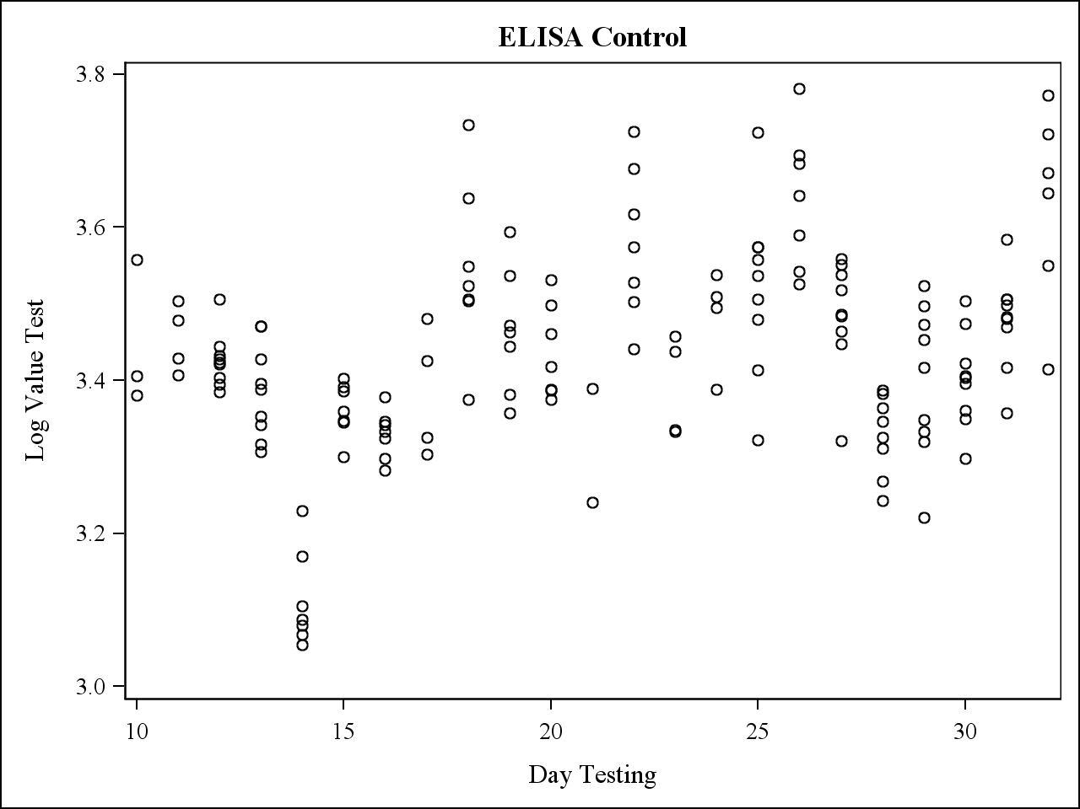
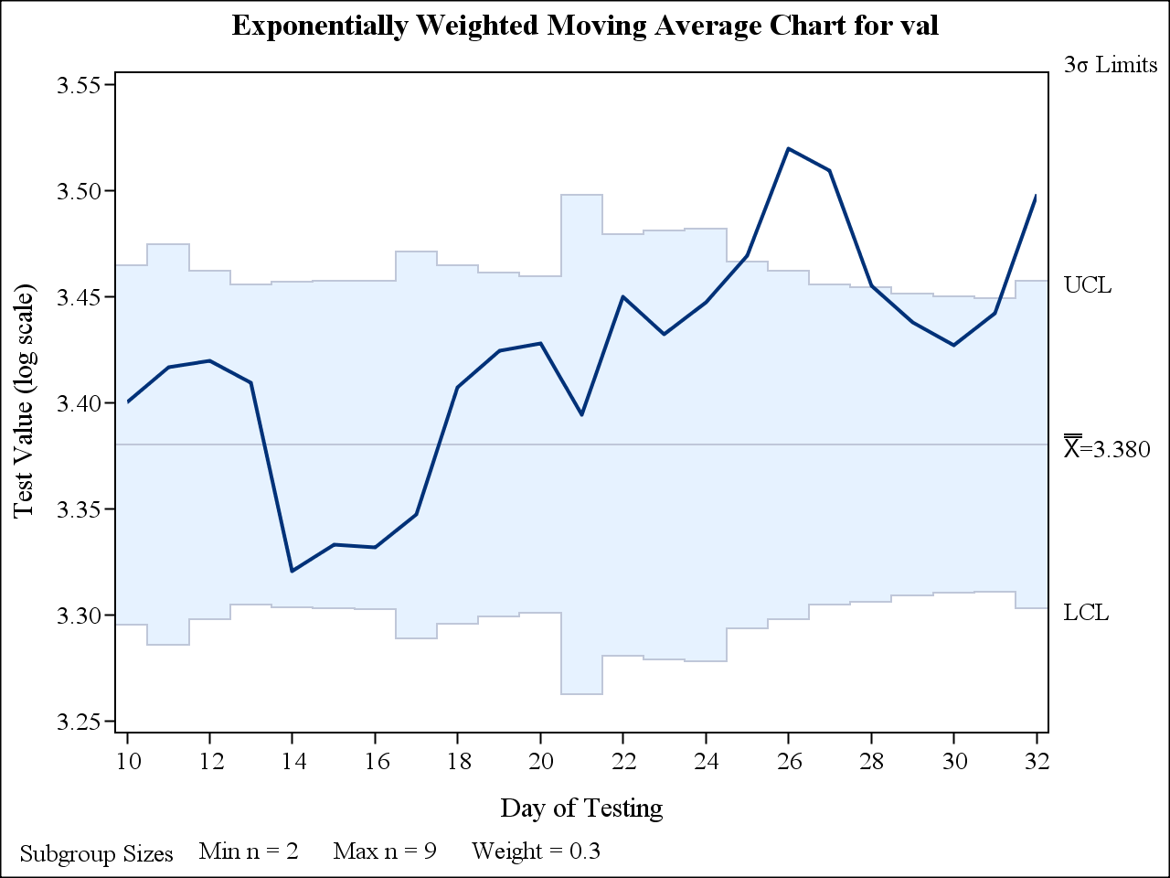
EWMA Control Chart When i.i.d.
${SD}_{EWMA}={SD}_{0}\sqrt{\frac{λ}{\left(2−λ\right)n}}$ for t large (t>10) and n_{t} = n (constant)
For general case formula (t small, n_{t} ) see Montgomery (1996)
Available in popular statistical software
Need to provide estimates of M₀ and SD₀ (=SD) to construct the bounds of EWMA
Notes:
Question that we will not directly adress here is estimation of M0 /SD0
General recommendation is to used at least 30 days of historical data (independent data) - should reflect total variability of the process – sometimes difficult to have more than 30 days
Also EWMA chart for mean – other charts to monitor variability – not discussed here
Influence of estimation of M0 /SD0 on properties of the chart should be studied in practice

Slide 7
Correlations: Assumptions
In practice, the i.i.d assumption is unrealistic in two ways
Within day correlation between assay runs (i.e. same raw materials)
Across days correlation (i.e. same operators)
Correlation structure assumptions
Within Day : CS structure for X_{t} → one parameter ρ
Across Days: AR(1) for Y_{t} → one parameter φ
Estimations from internal database screening
ρ in (0.3 – 0.8)
φ in (0 – 0.25)
Notes:
Correlations studied in database in ‘historical’ data
Depends on time between testing for φ

Slide 8
Within-day Correlations : Bounds
EWMA control limits of the average Y_{t} under CS (within-day):
$${SD}_{EWMA}=\frac{{SD}_{0}}{n}\sqrt{\frac{λ}{2−λ}(n+ρ (n^{2}−n))}$$
with constant n observations per day and t large
Need an estimate of $ρ$ (= within-day autocorrelation)
In practice, hardly estimable for each assay (> 300 assays!) → Can standard parameter settings be used?

Slide 9
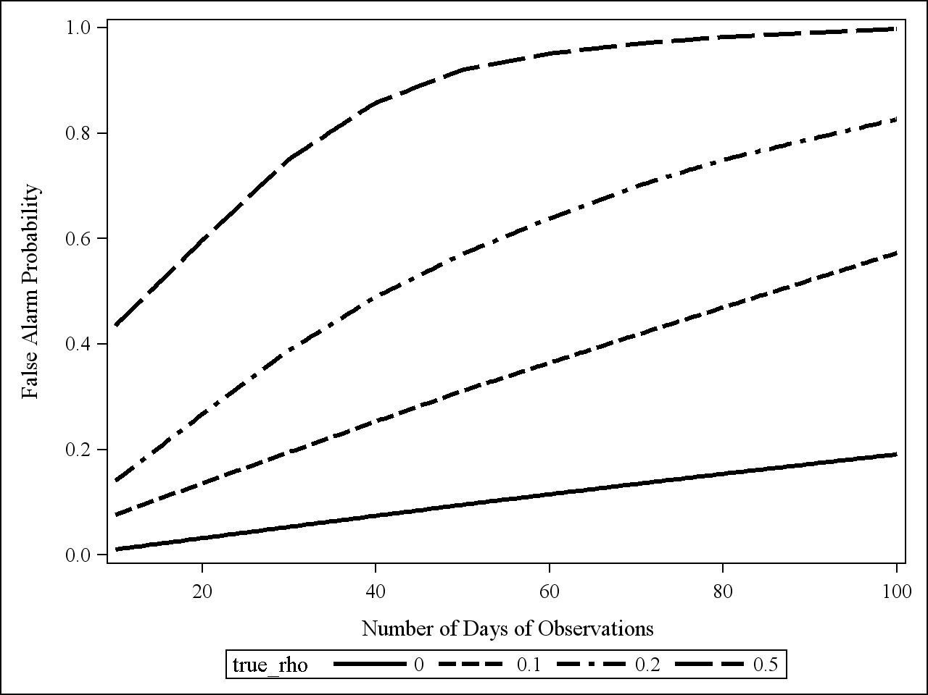
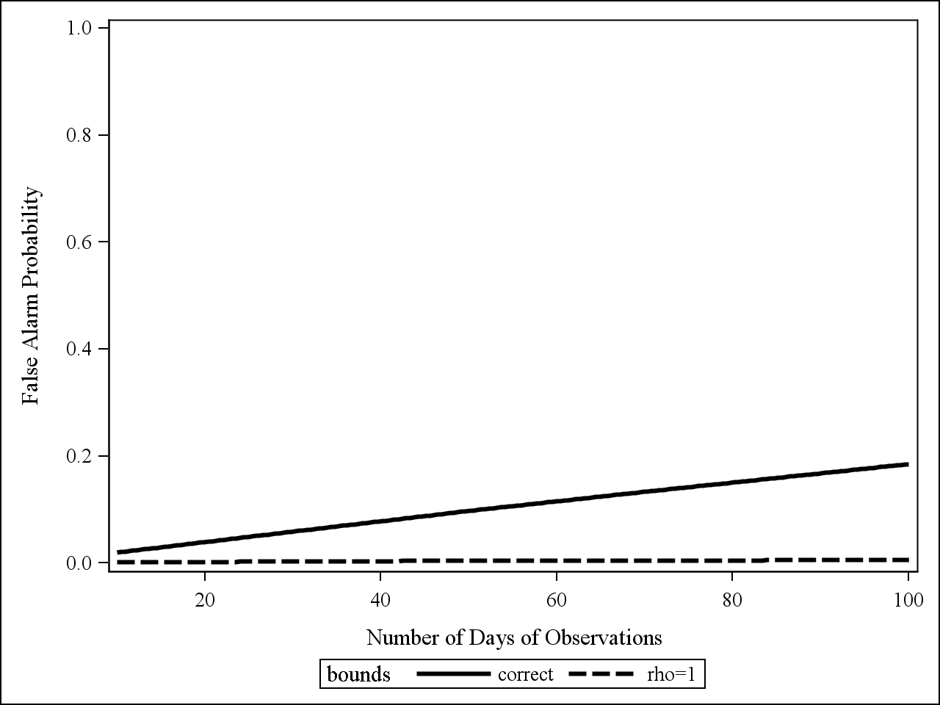
Within-day Correlations : False Alarms
Simulations assuming no shift in mean
Bounds with ρ = 0 (reality CS ρ = 0, 0.1, 0.2, 0.5)
Bounds with ρ = 0.5 or ρ = 1
(reality CS ρ = 0.5)
ρ increases
Ignoring the correlation structure (ρ=0) strongly increases false alert rates
→ Assuming maximal correlation (ρ = 1) decreases false alert rates.. (but Power??)
Notes:
Could use the exact ones after having estimated ρ but difficult to do in practice
If exact bounds are used false positive over x days is the ones corresponding to solid line (20% at least one false alarm over 100 days = 5 months minimum)
ARL = 300 (for practionners different message !!)
Use rho=0 ? What is the damage? (simulations)
If bounds match real process then false positive over 100 days is 20%
If bounds for iid variables are used then false positive over 100 days is high already after 20 days of observations and increases quickly with correlation

Slide 10
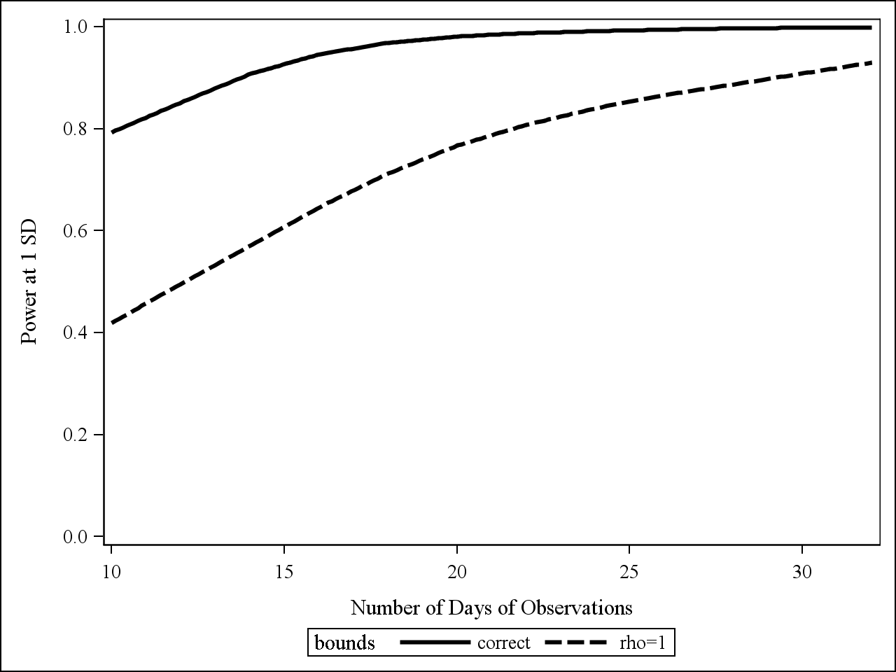
Within-day Correlations : Power
Simulations assuming shift in mean of 1 SD
Reality: X_{t ~} CS (ρ = 0.5)
EWMA bounds with ρ = 0.5 (correct bounds) or ρ = 1
Assuming ρ = 1 :
« No additional info obtained by repeating test same day »
Decreases power, but by an acceptable amount as t increases
Notes:
Assuming rho=1 for bounds computation ‘no additional info obtained by repeating test same day’ while rho <1 decrease power but ‘acceptable’ amount
Same results if n>5

Slide 11
Auto-Correlation Across Days
Control limits of EWMA of the average Y_{t} if Y_{t} ~AR(1) with φ
$${SD}_{EWMA, t}={SD}_{0}\sqrt{\frac{λ}{2−λ}(f(\text{φ},\text{λ})) }$$
For full description of f$(\text{},\text{λ})$, see Nien Fan Zhang, 1998, Technometrics, vol 40,1 formula (8)
Note that limits based on ${SD}_{EWMA, t}$ are wider than that of ordinary EWMA

Slide 12
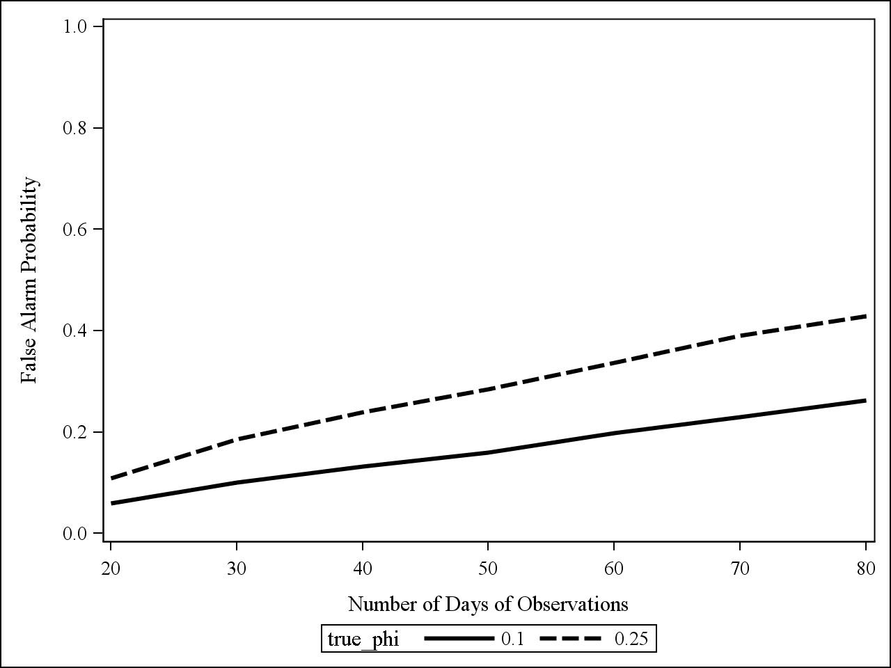
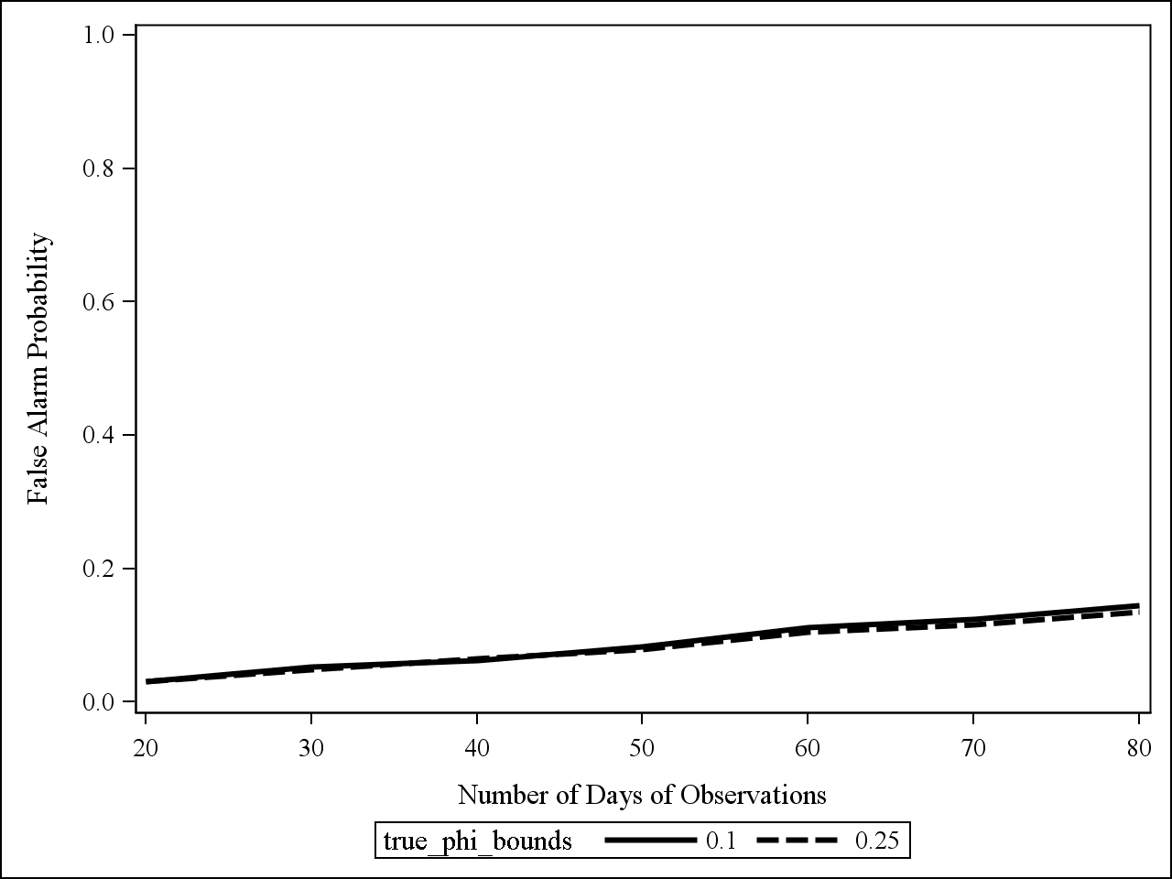
Auto-Correlation Across Days: False alerts
Simulations assuming no shift in mean
Bounds with $φ$ =0
Reality $φ$ = 0.10 or 0.25
Bounds with $φ$ =0.10 or 0.25
Reality $φ$ = 0.10 or 0.25
Ignoring the correlation structure (φ = 0) increases false alert rates compared to true correlation
Notes:
When phi=0 are used when process is AR(1) with phi=0.1 or 0.25, false alarm rate is higher than when correct bounds are used

Slide 13
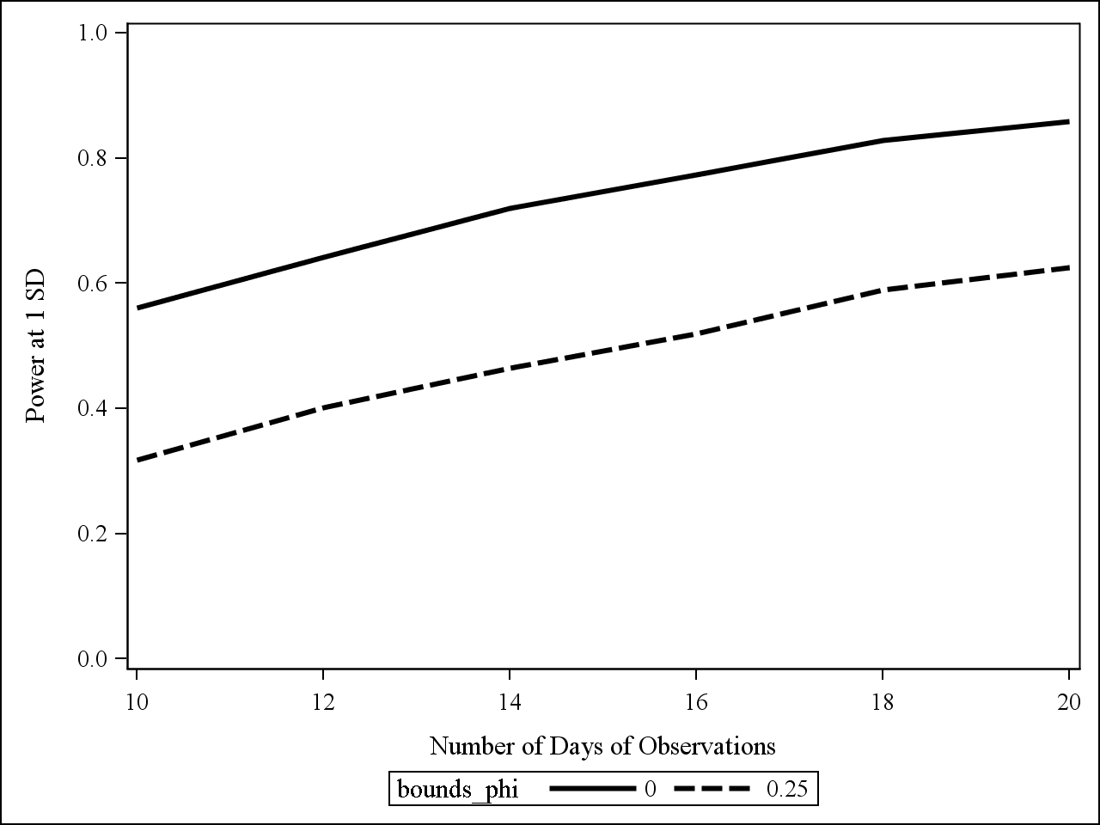
Auto-Correlation Across Days: Power
Simulations assuming shift in mean = 1SD
Reality Y_{t} is AR(1) with φ = 0.25
Bounds with φ =0 and φ= 0.25
Quantifies the time it takes to detect 1SD shift
If correct bounds are used power at 20 days is ~ 60%
(larger bounds)
If bounds = 0 are used, power at 20 days is ~ 80%
Notes:
If correct bounds are used for the AR(1) process, need at least 20 observations to detect 1SD with power >60%
If bounds =0 are used, power at 20 days is approx 80%
Quantifies the time it takes to detect 1SD shift

Slide 14
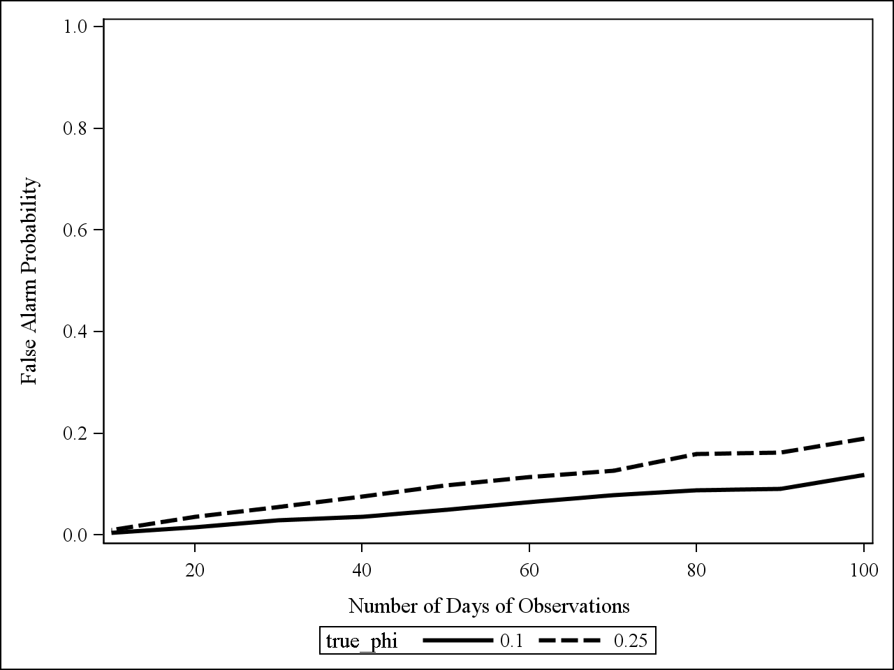
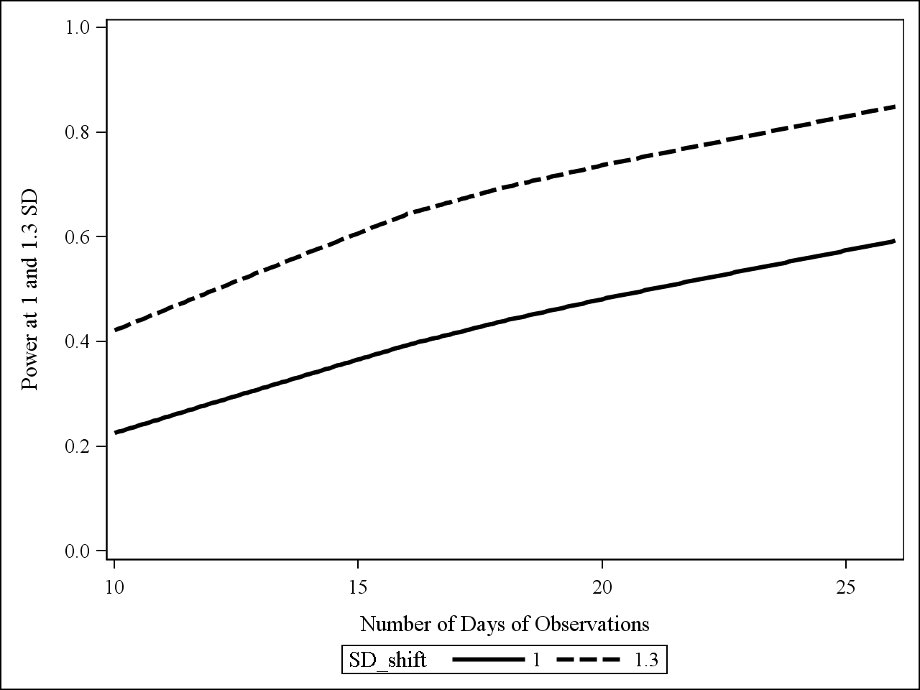
Auto-Correlations Within and Across Days
Reality : within-days ρ = 0.5 and across-days $φ$ in (0.1, 0.25)
EWMA bounds with $φ$ =0, ρ = 1
False alarm probability
Power at 1SD and 1.3SD
CV=30% :
1 SD shift : median 1000 to 1350
1.3 SD shift : median 1000 to 1500
Notes:
What if both ‘simplifications’ rho and phi are used at the same time ?
False positive rate kept under control (very important for practioners) – otherwise too costly

Slide 15
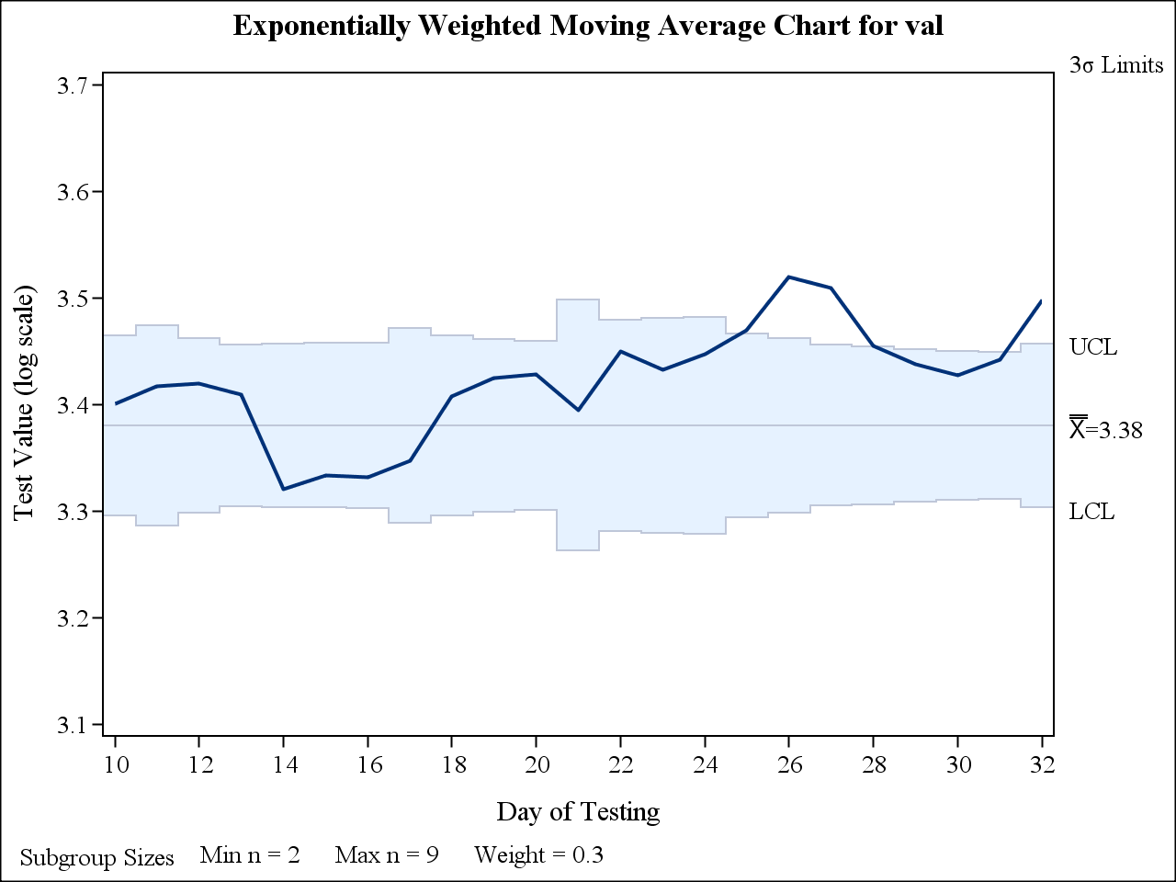
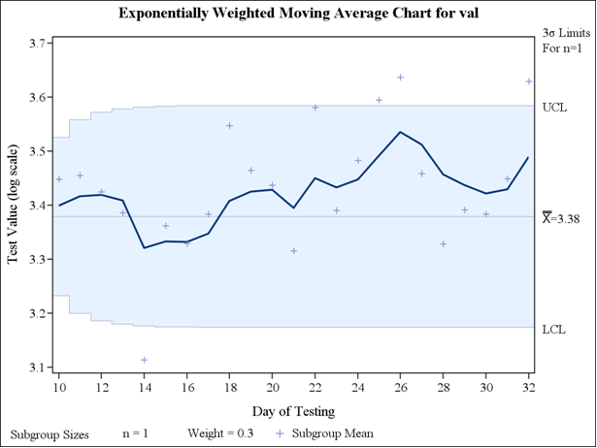
Back to the example
No autocorrelation structure
Bounds with ρ = 1, $φ$ =0
Estimated ρ = 0.8, $φ$ =0.2 → with n>20, power to detect a shift of 1.3SD > 80%
Notes:
Very important to translate power statement into something ‘understandable to practioners’
If for example, mean titers under control have a lognormal distribution with median 1000 and CV₀ = 30%, a shift of the mean equal to 1SD₀ corresponds to lognormal distribution of median 1350 while a shift of the mean of 1.3SD₀ corresponds to a median of 1500 approximately

Slide 16

Summary
Within-day correlation unknown
Use of ρ = 1 in EWMA bounds if in reality ρ <1
Decreases false alarm rate (compared to ignoring the structure)
Maintains reasonable power if ρ > 0.5
Across-day correlation unknown
Use of $ϕ$ = 0 in EWMA bounds if in reality $ϕ$ > 0
Increases the false alarm rate
Small increase of power compared to correct bounds

Slide 17
Take-home message (1/2)
Correlations exist in data collected for SPC, they should not be ignored
Theoretical work exists for EWMA charts in the presence of autocorrelations
Important to simulate and present different scenarios to practitioners
Need to understand properties of tool for structure of data at hand

Slide 18
Take-home message (2/2)
Construct EWMA assuming $φ$ =0, ρ = 1 for early stage
Limits the false alarm
Need at least 20 days of data to detect shift of 1SD – 1.3SD with reasonable chance
When data accumulates (N∼100), estimate $φ$
If $φ$ non-negligible, use correct bounds or average by week to decrease correlation across days

Slide 19
Discussion
Thank you for your attention
Any question ?
Acknowledgements Pierre Cambron (GVCL), Pascal Gérard (GVCL), Hélène Fourmanoir (stat), Jean-Louis Marchal (stat)

Slide 20
References
Montgomery D., Introduction to Statistical Quality Control, Wiley 4th edition 2001
Psarakis S. and Papaleonida G. E. A., SPC Procedures for Monitoring Autocorrelated Processes, Quality Technology & Quantitative Management Vol. 4, No. 4, pp. 501-540, 2007
Neubauer A., The EWMA control chart: properties and comparison with other quality-control procedures by computer simulation, Clinical Chemistry 43:4 594–601 1997
Shiau J.J.H. and Hsu Y.C., Robustness of the EWMA Control Chart to Non-normality for Autocorrelated Processes, Quality Technology & Quantitative Management Vol. 2, No. 2, pp. 125-146, 2005
Han D. and Tsung F., Run Length Properties of the CUSUM and EWMA Schemes for a Stationary Linear Process, Statistica Sinica 19, 473-490 (2009)
De Vargas, Dias Lopes, Souza, Comparative Study of the Performance of the CUSUM and EWMA Control Charts, Computers & Industrial Engineering 46, 707-724, 2004
Harris T. and Ross W., Statistical Process Control Procedures for Correlated Observations, The Canadian Journal of Chemical Engineering, 69, 48-57, 1991
Barger T., Zhou L., Hale M., Moxness M., Swanson S., Chirmule N. Comparing Exponentially Weighted Moving Average and Run Rules in Process Control of Semiquantitative Immunogenicity Immunoassays. The AAPS Journal, 12, 1, 2010

